Slide 1
CEC
Chapter 11
Chapter 7
Refinance
No Refinance
1st Lien paid at par
They may refinance but the question is when. If the spring maturity clause is triggered, then the company must refinance this 90 days before 2nd lien, which adds more pressure to the company given such short time span.
2nd lien paid at par
I think this is a more probable outcome because the near maturity date and there’s a spring maturity clause for the 1st lien which takes more to refinance
Asset Sales
Leaseback
The question is when. Apparently, there is a large sum of interest payment coming up. The company might be able to pay it off using revolver but that would leave only $60m to fund its operations. I need to find out a breakdown of the store-level economics by delivery/eat-in.
Would be useful to look at the delivery habits and spending powers over the states. From a top-down perspective, there are couple of scenarios to consider.
Best case: as temperature rises, the virus goes away. Businesses resume normal activities in the summer. And it’s the holiday season, so we might see revenues coming in for CEC stores.
W-shaped recovery: there might be some second round of the pandemics and even when the virus is gone, there’s no guarantee that the economy would recover on a timely manner. Therefore, people would curb their spending on discretionary sectors, which CEC is in.
L-shaped recovery: due to the high debt level and the flaccid capital market, the firm cannot refinance its debt obligations, so, a liquidation or huge haircut restructuring is needed. The key is how Apollo would play. If they believe that the company has great asset base, they might inject equity cure. Or, they can try too see if leaseback is a feasible choice for some of the outperforming stores. Or, can they carve out the peter piper business? Like why did they integrate PPP? How much was it?

Slide 2
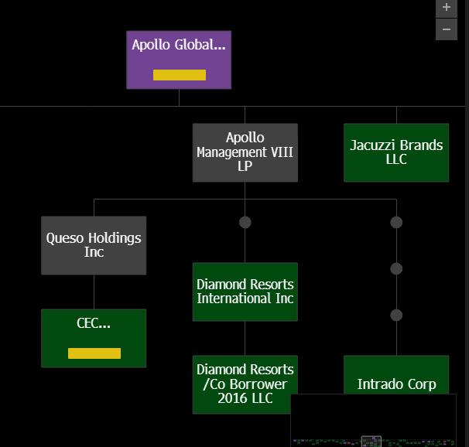
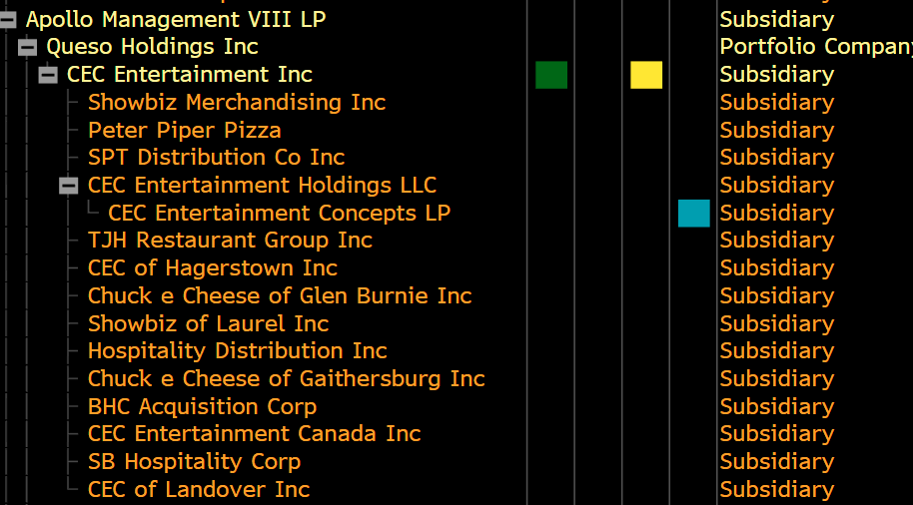
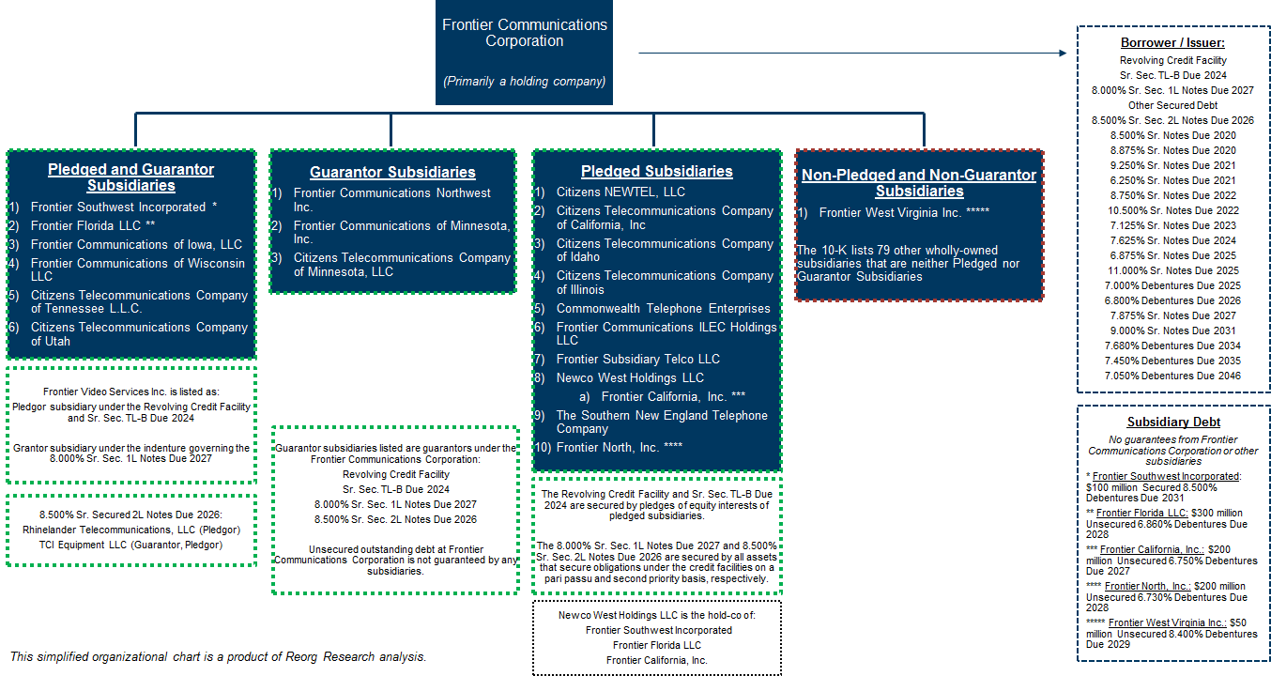
Apollo Global MAange

Slide 3
Limited Partners
Apollo Global Management, Inc and General Partners
Apollo Management VIII, LP
Queso Holding, Inc
1st Lien Secured Loan
114m RCF due 2024
760m TLB due 2026
Equity collateral
CEC Entertainment, LLC
Senior Unsecured Bond
255m due 2022
Restricted Subsidiaries
Unrestricted Subsidiaries
Guarantor
Collateral

Slide 4
Initial Thesis
Long 8.0% Senior Unsecured due 2022 @ 48c, target price at par
Spring maturity clause only applicable for the existing facility. Since the senior secured is a significant amount, triggering this spring maturity would be disastrous to the company. It is like to have this 225m senior unsecured refinanced by a secured or another unsecured lender.
You can’t really liquidate the company, at least IMO the 1st lien lender wouldn’t want to do so because a majority of company’s venues are leased, therefore cannot be sold for cash proceeds.
Instead, the company might operate as a going-concern, but engage in some sale leaseback agreements to ease the burden.
The company has way too many stores than necessary, assume you can lease back each store for 2m, 300 of them can be sold for 600m. And the company can close oversea stores and liquidate equipment, that would pay off the senior secured.
Further, if the company is to refinance the unsecured, then 1st would have a longer maturity date to 2026. That would be enough breathing room for the company to recover and perhaps pay down using the FCF.
So, a second thesis would be a strip of both tranches with a ratio of 1:5. That is, for every $1000 of 1st lien, we buy $5000 of Senior Unsecured.
The major problem is that the company might not be able to refinance. So, it makes economic sense to use sale leaseback proceeds to repay the senior unsecured first, because 1) it’s more interest burden @ 8%, 2) it’s only 225m outstanding so the company does have to leaseback that much and 3) invalidate the spring maturity.
We also want to buy 1st lien because the design of the credit agreements allow the company to extend coercive exchange offer. At 48.25, the company may offer at 60, effectively reducing the leverage to 2.5x thru 1st lien vs. the initial 4.8x.
I don’t think a coercive exchange offer is a reasonable move for unsecured lenders because the first lien might strongly object, and the company is not really reducing that much of leverage. But, if the company is able to exchange the first lien AND leaseback all 113 foreign stores, then the leverage is effectively only 2.5x.

Slide 5
Downside
Well if the company cannot lease back any store or refinance, that means the company will have to go through asset sales to pay off the 1st lien holders, which essentially leaves nothing for senior unsecured.
That is why we can purchase some 1st lien to hedge that risk.

Slide 6
Around 2006, changed the strategic expansion to metropolitan areas because the honeymoon curve in small markets is more dramatic than bigger markets
Capex on remodeling. 500k per store. Done 10 already, targeting 40-50 more this year.
2007 AUV of 1.6 but still the same in 2019

Slide 7
1977: 1st location opened in San Jose, CA. Labeled as the first family restaurant to integrate food, animation, and an indoor arcade
1984: as a result of the “video game crash of 1983”, the company filed for bankruptcy to restructure its insurmountable debt obligations
Feb. 2014: Apollo takes the company private for $54 per share. The deal was structured with 1st lien facility consists of a $150 million undrawn revolver and a $760 million TLB, and a senior unsecured bond of $255 million
Oct. 2014: CEC acquired a competitor, Peter Piper Pizza, which adds 32 company owned locations and 155 franchises
2014-2019: the company has been moderately adjusting its store base to 741 system-wide venues
2019: the company tried to go IPO through a merger with Leo Holdings (Apollo owns 55%) but the deal was terminated in the summer. The company refinanced its 1st lien debt with a Spring Maturity added
Today: the RCF is fully drawn; 50% of work force furloughed; expect to close ~80 venues this year; all venues only do delivery and pick-ups

